Slide 1
CS 4530: Fundamentals of Software Engineering Module 1.2: From Requirements to Code
Adeel Bhutta, Mitch Wand, Joydeep Mitra
Khoury College of Computer Sciences
© 2025 Released under the CC BY-SA license

Slide 2
Learning Goals for this Lesson
At the end of this lesson, you should be prepared to
???
TODO update
Notes:
<read slide>

Slide 3
Non-Goals for this Lesson
This is *not* a tutorial for Typescript or for Vitest
We will show you simple examples, but you will need to go through the tutorials to learn the details.
Notes:
This is part of our overall metaphor of you (the student) learning what it’s like to be a software developer on a new team. As a new team member, you will be expected to learn a lot of new stuff in a hurry, by yourself: new languages, new development environments, etc.
We’ll have tutorials and other training materials, but we won’t be spending a lot of class time on them.

Slide 4







The big picture
PEOPLE
PROCESSES
PROGRAMS
PLANNING
user stories
ORGANIZING
and
conditions of satisfaction
implementing
Notes:
This is a refinement of the way we introduced user stories.
x-Driven Design and other ways of capturing requirements help us understand and communicate what we’re planning to do.
Connecting user stories with conditions of satisfaction is how we organize our software engineering process — that’s central to what we’re doing in this class.
This lecture starts with requirements analysis and ends with test-driven development: the way we ensure our conditions of satisfaction are connected to

Slide 5
Part 1: Requirements analysis
PEOPLE
PROCESSES
PROGRAMS
PLANNING
Requirements Analysis
User Stories
Testing Conditions of Satisfaction
ORGANIZING
implementing
Notes:
This lecture has two parts:
- We’re going to talk about how we decide what user stories to select as part of our planning
- We’re going to talk about test-driven development, and how it connects our conditions of satisfaction to our actual code
Our TAs will judge whether your essential conditions of satisfaction represent an MVP for your user story. But they mostly won’t be judging whether your user stories are user stories worth doing.
In other words, we mostly see it it as a technical decision about how to satisfy a user story — a complex technical decision that involves design, but a technical decision? Who decides what actual software should get built, what user stories should get prioritized? How do they
decide?
DISCUSS
Who do you think gets to decide what user stories actually get prioritized in practice?

Slide 6
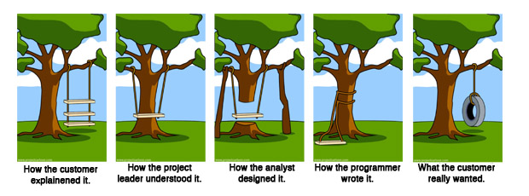
Overall question: How to make sure we are building the right thing
https://en.wikipedia.org/wiki/Tree_swing_cartoon
Notes:
The overall question for Requirements Analysis is making sure that we are building the right thing.
This meme does a great job capturing the many ways in which we can get off course and end up building the wrong thing. It may not be surprising that this meme dates back to at least the 1970’s, and long before the internet, was photocopied and hung up on the wall in many offices, particularly at software companies. These are not new problems: understanding what the customer wants the software to be, and then ensuring that we implement something that solves that problem is not easy.

Slide 7
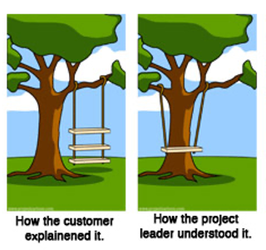
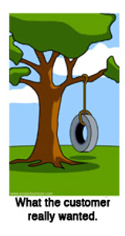
Why is requirements analysis hard?
Problems of understanding
Do users know what they want?
Do users know what we don’t know?
Do we know who are users even are?
Problems of scope
What are we building?
What non-functional quality attributes are included?
Problems of volatility
Changing requirements over time
7
Notes:
While getting the right requirements can certainly help make sure we build the right thing, it definitely doesn’t guarantee it.
Consider right now an example developing of a virtual meeting platform. With the start of the COVID-19 pandemic, and shift to virtual meetings, there has been an enormous demand for software to help substitute for physical events. But, even today, many platforms still don’t provide the experience that users want: how do you replace some physical interactions with a software product? These kind of challenges come up all of the time in software projects.
Sometimes, clients want to bring software in to solve some problem that is currently not being addressed, but don’t know exactly how to solve it. In other times, new software is brought in as a technology to improve an existing process. There is a way that things are done, and your software is going to help that get done better. In those situations, the client may simply not know what will work best for them.
Software engineering aims to provide answers, or at least a framework for answers to these questions
<Read slide. Possible elaboration:>
Examples of problems of understanding corresponding to the bullets:
What they want? -> Simply don’t know what is possible, won’t know it until they see it, often know what the problem is that they want the software to solve, but not the solution. Coming up with the solution is a design problem. Good to have a buddy who is a user experience designer.
What we don’t know? -> Most software is not “general purpose”, but exists within some domain.
Who are our users? -> Maybe most common in startups, where you have a client (moneybags investors) who are guessing who your users will be and what they want
Scope - What are we building? -> How to agree with client on a statement of work that is feasible given constraints, how to make sure that we stay on track?
Scope – quality attributes -> How to specify things like performance, usability, maintainability, security, etc
Volatility -> Long projects are subject to changes in world around them

Slide 8
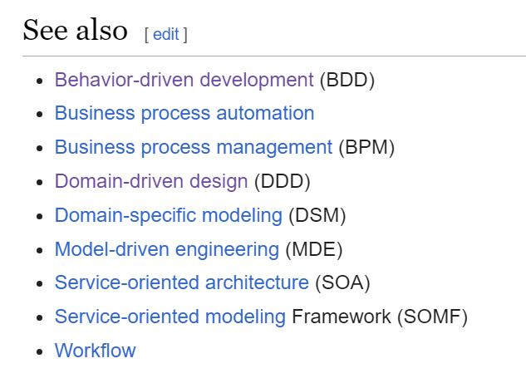
How do we capture the requirements?
There are many methodologies for this.
Often described as x-Driven Design (for some x)
They differ in scope & details, but they have many features in common.
Notes:
In this lesson, we'll primarily be concerned with problems of understanding. How do we get from a customer's vague notions of what they might want to something concrete enough to guide us to build it.
<read slide>

Slide 9
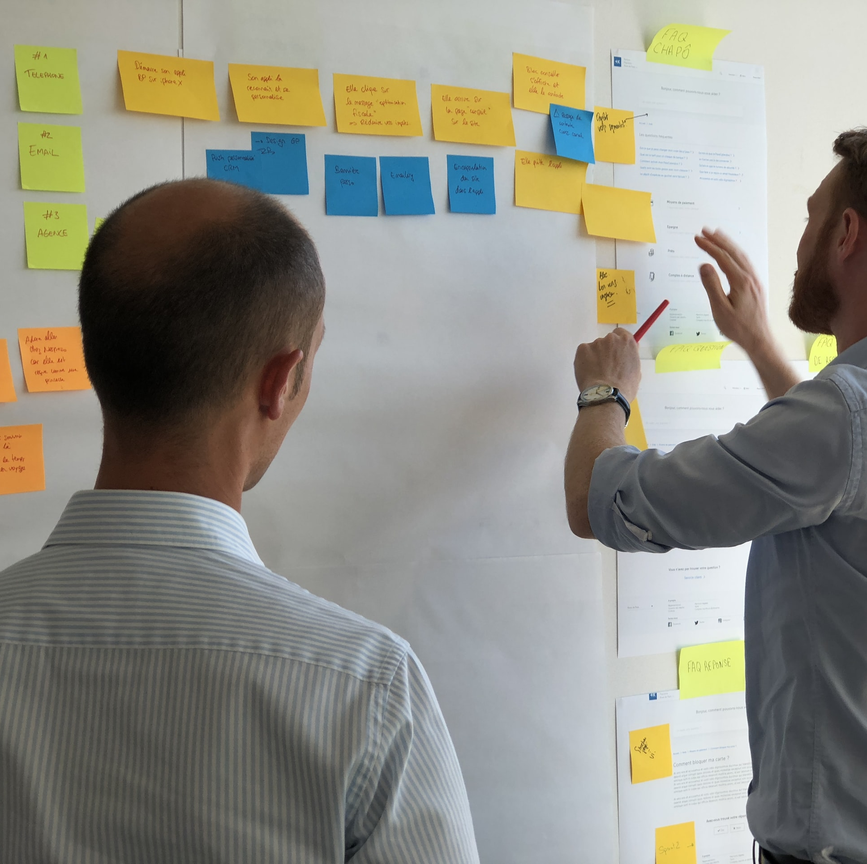
Common Elements
Meet with stakeholders
Develop a common language
Collect desired system behaviors that offer value
Document the desired behaviors
Iterate and refine!!
User stories are the least common denominator of most approaches
Notes:
Here are some things that these different methods have in common. Notice two important things: stakeholders and value <read slide>
The artifact produced by these common elements is user stories!

Slide 10

Requirements gathering frameworks inform the structure and priority of user stories
“Building the right thing” is necessarily a value judgment
(right for whom? who benefits?)
You need some way to think about what capabilities you shouldn’t implement!
Your scientists were so preoccupied with whether or not they could, they didn't stop to think if they should."
- Ian Malcom (in Jurassic Park, 1993)
Notes:
.

Slide 11
Requirements gathering frameworks inform the structure and priority of user stories
Value Sensitive Design (VSD) is one framework recommends paying special attention to stakeholders and human values when writing and prioritizing user stories
Combines empirical, value, and technical
Notes:
The process of VSD includes three kinds of investigations:
Empirical: This is about understanding how the value works in real life based on observations made in the field or from life experiences.
Value: Involves identifying stakeholders, thinking about their goals and values and then finally resolving the value tensions arising from conflicting interests of stakeholders.
Technical: The technical feasibility of implementing the solutions.

Slide 12
VSD Example – Informed Consent
Empirical Investigation:
Understand what we mean by informed consent, encompasses:
Disclosure. Do we know the pros and cons of taking an action?
Comprehension. Do we understand the disclosures?
Voluntariness. Is there coercion or manipulation?
Agreement. Is there a clear opportunity to consent or not?
Competence. Are we capable to give consent?
Values Investigation:
Who are the direct and indirect stakeholders?
Do the stakeholders have conflicting values?
How can we resolve them?
Technical Investigation:
What are the technical mechanisms for implementing informed consent.
One way => cookie consent management system.
Websites use them to obtain and manage user permission for using cookies.
Read the tutorial!
Notes:
The slide illustrates how to use VSD to think about a value like informed consent:
Do an empirical investigation which involves understanding the meaning of the value. In this case understanding informed consent hinges on four concepts as outlined. Often to understand a value one will have to collaborate with experts in a field such as sociologists, philosophers, domain experts.
Identify the stakeholders and value tensions. For e.g., the stakeholders here could be site users and site owners. Their interests may align or conflict. For e.g., site users may want to be anonymous, but site owners might want to monetize site usage by sharing personal usage data with advertisers. On the other hand they may align if the site owners want to make accountability and transparently a core value of their operations.
Cookies in browsers are one way to collect personal information after taking permission from the users.

Slide 13
Part 3: Test-Driven Development
PEOPLE
PROCESSES
PROGRAMS
PLANNING
Requirements Analysis
User Stories
Testing Conditions of Satisfaction
ORGANIZING
implementing
Notes:
Requirements analysis is the name we’re giving to the broad planning process where we decide what the user stories are, and which oens we should focus on. Requirements analysis mostly deals with user stories — it will also inform conditions of satisfaction.
The rest of this lecture is about test-driven development which is primarily about the relationship between conditions of satisfaction and code — though it is also informed by what the user stories are

Slide 14

Review: User Stories
As a College Administrator, I want to keep track of students, the courses they have taken, and the grades they received in those courses, so that I can advise them on their studies.
As a <role> I want <capability>
so that I can <get some benefit>

Slide 15
Review: Conditions of Satisfaction
We will build a secure web application backed by a persistent database that allows an authenticated administrator to:
Add a new student to the database
Add a new student with the same name as an existing student.
Retrieve the transcript for a student
Delete a student from the database
Add a new grade for an existing student
Find out the grade that a student got in a course that they took

Slide 16
Test Driven Development (TDD)
Puts test specification as the critical design activity
Understands that deployment comes when the system passes testing
The act of defining tests requires a deep understanding of the problem
Clearly defines what success means
No more guesswork as to what “complete” means
Notes:
As we saw in the preceding lecture, is a whole alphabet soup of paradigms to structure your design and/or development activities, be they in agile or not. Behavior driven design, model driven development, feature driven development, and more.
As we also said last time, we are going to focus on one of these methodologies that is most strongly embraced by agile, and which we encourage you to use in your project: Test driven development (TDD).
The key idea behind TDD is to develop your design based on your tests. Given that you have collected user stories and conditions of satisfaction, the expected behavior of your code should be apparent. So, codify that expected behavior into tests, before proceeding with your development.
As you define your tests, use your tests to influence your overall software design.
With tests defined first, there should be no more guesswork of “whether you are done”

Slide 17
The TDD Cycle
Analyze
Design
Code
Satisfaction Conditions
Testable Behaviors
Executable Tests
Executing Code
Negotiate
Negotiate
Notes:
Here's a depiction of the TDD cycle. It may be a little different from what you’ve seen before.
To see what all this means, we’ll work through a small example. Along the way, we’ll learn a little Typescript and a little Jest, just enough to do the example.
We start with the user’s satisfaction conditions. We first refine those to come up with testable behaviors– concrete, testable things that our system should do. Along the way, we may discover some design decisions that we need to make. We resolve these by negotiating with the client.
Our next step is to turn these testable behaviors into executable tests. To do this, we will need to design some of our program– at the very least, we will have to decide on the names of the things we will test. We may discover more decisions that we resolve in negotiation with the client.
Finally, we write some code that will pass our tests.
We probably do this one user story or one condition of satisfaction at a time.

Slide 18
CoS are ultimately about the user
We will build a secure web application backed by a persistent database that allows an authenticated administrator to add a new student to the database
Database
API
Service
API
Controller
internet
Web Application
browser
User

Slide 19
CoS are ultimately about the user
We will build a secure web application backed by a persistent database that allows an authenticated administrator to add a new student to the database
The addStudent service function should add a student to the database
Database
API
Service
API
Controller
internet
Web Application
browser
User
Notes:
Both of these can be connected to testable behaviors! But it’s much easier to write executable tests checking testable behaviors at the service later.

Slide 20
Analyzing CoS to get testable behaviors
import {
StudentID,
Student,
Course,
CourseGrade,
Transcript,
} from './types.ts';
export interface TranscriptService {
addStudent(studentName: string): StudentID;
getTranscript(id: StudentID): Transcript;
deleteStudent(id: StudentID): void; // hmm, what to do about errors??
addGrade(id: Student, course: Course, courseGrade: CourseGrade): void;
getGrade(id: Student, course: Course): CourseGrade;
nameToIDs(studentName: string): StudentID[];
}

Slide 21
Analyzing CoS to get testable behaviors
CoS: The user can…
…add a new student to the database
…add a new student with the same name as an existing student
…retrieve the transcript for a student
Testable behaviors:
addStudent should add a student to the database and return their ID
addStudent should return an ID distinct from any ID in the database
addStudent should permit adding a student with the same name as an existing student
Given the ID of a student, getTranscript should return the student’s transcript.
Given an ID that is not the ID of any student, getTranscript should …????...

Slide 22
The tiniest introduction to Vitest
// transcript.service.ts
import {
StudentID,
Student,
Course,
CourseGrade,
Transcript,
} from './types.ts';
export interface TranscriptService {
addStudent(studentName: string): StudentID;
getTranscript(id: StudentID): Transcript; // throws Error if id invalid
deleteStudent(id: StudentID): void; // throws Error if id invalid
addGrade(id: Student, course: Course, courseGrade: CourseGrade): void;
getGrade(id: Student, course: Course): CourseGrade;
nameToIDs(studentName: string): StudentID[];
}

Slide 23
The tiniest introduction to Vitest
// types.ts - types for the transcript service export type StudentID = number;
export type Student = { studentID: number; studentName: StudentName };
export type Course = string;
export type CourseGrade = { course: Course; grade: number };
export type Transcript = { student: Student; grades: CourseGrade[] };
export type StudentName = string;

Slide 24
The tiniest introduction to Vitest
// types.spec.ts import { describe, expect, it } from 'vitest';
import { type Student } from './types.ts';
const alvin: Student = { studentID: 37, studentName: 'Alvin' };
const bryn: Student = { studentID: 38, studentName: 'Bronwyn' };
describe('the Student type', () => {
it('should allow extraction of id', () => {
expect(alvin.studentID).toEqual(37);
expect(bryn.studentID).toEqual(38);
}); it('should allow extraction of name', () => {
expect(alvin.studentName).toEqual('Alvin’);
expect(bryn.studentName).toEqual('Jazzhands’); // will fail
});
});

Slide 25
The tiniest introduction to Vitest
% npx vitest --run types.spec.ts
RUN v3.1.2 /Users/rjsimmon/r/strategytown-su25/client
❯ types.spec.ts (2 tests | 1 failed) 4ms
✓ the Student type > should allow extraction of id 1ms
× the Student type > should allow extraction of name 3ms
→ expected 'Bronwyn' to deeply equal 'Jazzhands'
⎯⎯⎯⎯⎯⎯⎯⎯⎯⎯⎯⎯⎯⎯⎯⎯⎯⎯⎯⎯⎯⎯⎯⎯⎯⎯⎯⎯⎯⎯⎯⎯⎯⎯⎯⎯⎯⎯⎯⎯⎯⎯⎯⎯⎯⎯⎯⎯⎯⎯⎯⎯⎯⎯ Failed Tests 1 ⎯⎯⎯⎯⎯⎯⎯⎯⎯⎯⎯⎯⎯⎯⎯⎯⎯⎯⎯⎯⎯⎯⎯⎯⎯⎯⎯⎯⎯⎯⎯⎯⎯⎯⎯⎯⎯⎯⎯⎯⎯⎯⎯⎯⎯⎯⎯⎯⎯⎯⎯⎯⎯⎯⎯
FAIL types.spec.ts > the Student type > should allow extraction of name
AssertionError: expected 'Bronwyn' to deeply equal 'Jazzhands'
Expected: "Jazzhands"
Received: "Bronwyn"
❯ types.spec.ts:16:30
14| it('should allow extraction of name', () => {
15| expect(alvin.studentName).toEqual('Alvin');
16| expect(bryn.studentName).toEqual('Jazzhands');
| ^
17| });
18| });
⎯⎯⎯⎯⎯⎯⎯⎯⎯⎯⎯⎯⎯⎯⎯⎯⎯⎯⎯⎯⎯⎯⎯⎯⎯⎯⎯⎯⎯⎯⎯⎯⎯⎯⎯⎯⎯⎯⎯⎯⎯⎯⎯⎯⎯⎯⎯⎯⎯⎯⎯⎯⎯⎯⎯⎯⎯⎯⎯⎯⎯⎯⎯⎯⎯⎯⎯⎯⎯⎯⎯⎯⎯⎯⎯⎯⎯⎯⎯⎯⎯⎯⎯⎯⎯⎯⎯⎯⎯⎯⎯⎯⎯⎯⎯⎯⎯⎯⎯⎯⎯⎯⎯⎯⎯⎯⎯⎯⎯⎯⎯⎯⎯⎯⎯⎯⎯⎯⎯[1/1]⎯
Tests 1 failed | 1 passed (2)

Slide 26
Turning testable behaviors into Vitest tests
// transcript.service.spec.ts import { beforeEach, describe, expect, it } from 'vitest';
import { TranscriptDB, type TranscriptService } from ‘./transcript.service.ts';
let db: TranscriptService;
beforeEach(() => {
db = new TranscriptDB();
});
describe('addStudent', () => {
it('should add a student to the database and return their id', () => {
expect(db.nameToIDs('blair')).toStrictEqual([]);
const id1 = db.addStudent('blair’);
expect(db.nameToIDs('blair')).toStrictEqual([id1]);
});
});
Start each test with a new empty database

Slide 27
Turning testable behaviors into Vitest tests
describe('addStudent', () => {
it('should add a student to the database and return their id', () => {
expect(db.nameToIDs('blair')).toStrictEqual([]);
const id1 = db.addStudent('blair’);
expect(db.nameToIDs('blair')).toStrictEqual([id1]);
});
});
Assemble (and verify)
Act
Assess
Notes:
In order to run a test, we need to first ASSEMBLE it. This may include creating instances of classes/variables, setting up test data for inputs, etc. We should always check to see that we’ve set it up correctly. Here most of the work has already been done in the beforeEach block.
Then we ACT: we do the action under test.
Last, we ASSESS: we check to see that the response was acceptable. In Vitest, this is done by the expect function; in other testing frameworks this is called assert. Note that the test uses some methods other than the one we’re testing; we’ll write tests for nameToIds separately.
Another way of looking at this is that this test is not just about addStudent; it’s making sure that addStudent and nameToIds cooperate (or conspire) together to produce the desired behavior.

Slide 28
Turning testable behaviors into Vitest tests
describe('addStudent', () => {
it(‘should return an ID distinct from any ID in the database', () => {
// we'll add 3 students and check to see that their IDs are all different.
const id1 = db.addStudent('blair’);
const id2 = db.addStudent('corey’);
const id3 = db.addStudent('del’);
expect(id1).not.toEqual(id2);
expect(id1).not.toEqual(id3);
expect(id2).not.toEqual(id3);
});
});
Notes:
(review Assemble-Act-Assess)

Slide 29
Turning testable behaviors into Vitest tests
describe('addStudent', () => {
it('should permit adding a student w/ same name as an existing student’, () => {
const id1 = db.addStudent('blair’);
const id2 = db.addStudent('blair’);
expect(id1).not.toEqual(id2);
});
});

Slide 30
Turning testable behaviors into Vitest tests
describe('addStudent', () => {
it('should permit adding a student w/ same name as an existing student’, () => {
const id1 = db.addStudent('blair’);
const id2 = db.addStudent('blair’);
expect(id1).not.toEqual(id2);
});
});
TODO error example

Slide 31
A quick word about cleanup
Start each test with a new empty database
beforeEach(() => {
db.initialize([]);
});
describe('tests for addStudent', () => {
test('addStudent should add a student to the database', () => {
expect(db.nameToIDs('blair')).toEqual([])
const id1 = db.addStudent('blair');
expect(db.nameToIDs('blair')).toEqual([id1])
});
TODO update
Our test left a student in our database at the end of the test.
Use afterEach() if needed.
Notes:
Sometimes you want to make sure that the system under test is in a particular state before you start the test. Jest, and most other frameworks, allow you to do that by writing a beforeEach block.
Our tests do, in fact, make changes to the database. In this case, we can undo those changes in the beforeEach block. If our tests did other things, like connect to an external data source, then we'd need to disconnect at the end of each test; this can be done by an afterEach.

Slide 32
…now TDD lets us implement addStudent!
Implementing the TranscriptDB according to the TranscriptService spec will let us turn our testable behaviors into fully executable tests.
Analyze
Design
Code
Satisfaction Conditions
Testable Behaviors
Executable Tests
Executing Code

Slide 33
Review
It’s the end of the lesson, so you should be prepared to:
TODO update

